Slide 1
Facilitator Guide
Initiate Workshop
Version 0.2
Last modified by Carrie Rogers 2022-05-24

Slide 2
Contents
Facilitators Guide to Running an Initiate Mode
Overview
Process
Outputs
Supporting Tools & Techniques

Slide 3
Overview

Slide 4
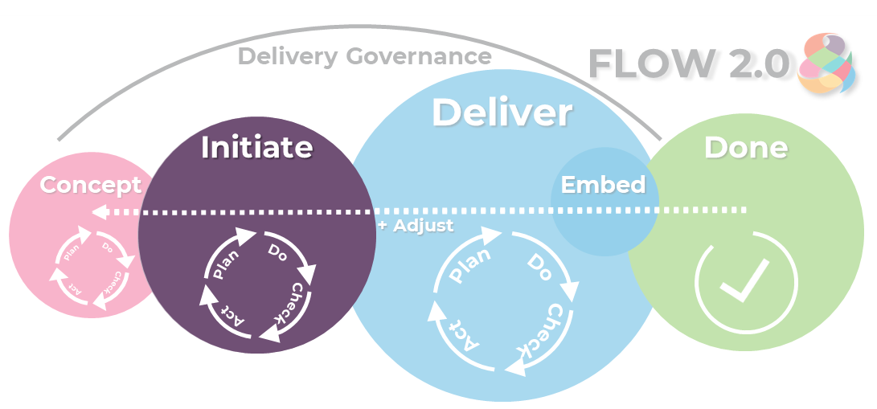
Overview
The objective of Initiate phase is to…
Understand the work to be done, including the business rules or business logic and functional decomposition of the initiative.
Agree delivery approach and define, prioritise and plan the work units
Understand and plan the tech stack, the work environment – including Dev/Test environments
Make a ‘go/no go’ decision on moving into Deliver

Slide 5
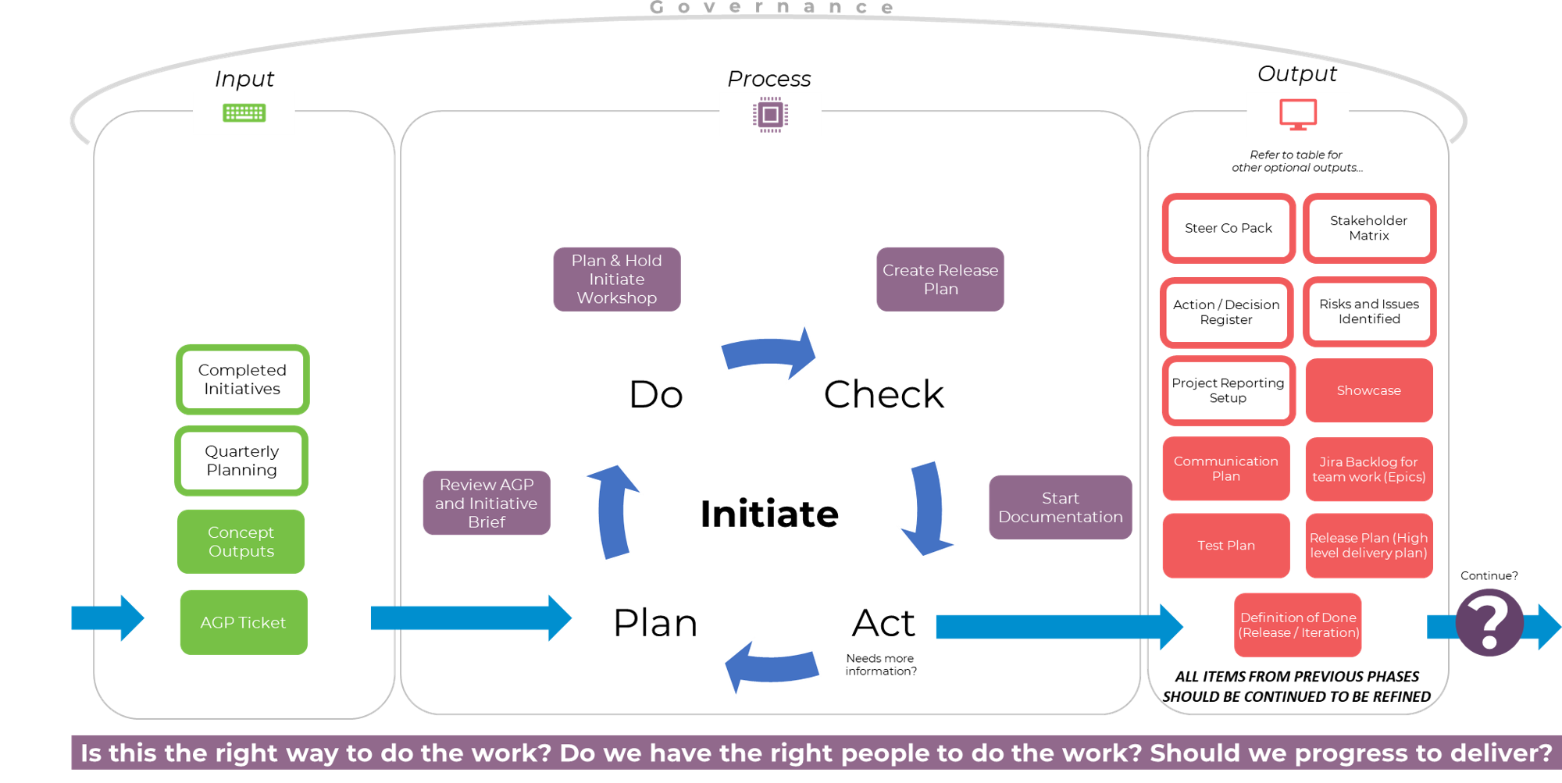

Slide 6
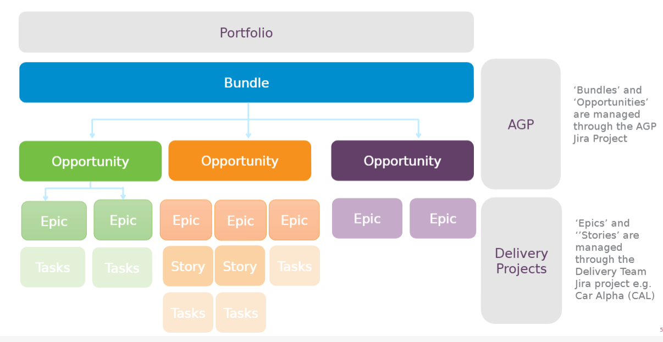
Idea Maturity
This work breakdown happens during Concept phase
During Initiate we validate the outputs created during concept.
We do this by breaking the work down into Epics and the first set of stories that we intend on working on (Sprint 1 at least).
The process further matures our idea and collective understanding.
We do not break down ALL Epics at the outset, but do this on a rolling basis.
Note: Not every initiative will have a Bundle, and some may not have Stories. It depends on the size and complexity of the change.
This work breakdown happens during Initiate phase

Slide 7
Process
Delivery team/s will be engaged more in the detail of the change, and will elaborate and break up work into right-sized chunks.

Slide 8
Activities
Review AGP details and Outputs of Concept phase
Plan & Hold Initiate Workshop and agree supporting activities
Plan & Hold supporting activities as agreed during Initiate workshop
Create Plans and update Confluence with relevant links
Create Epic backlog
Get Agreement to Proceed
Note: The bold steps are included in this pack – initiate is more than the workshop it is a series of workshops and activities outside of the workshop.

Slide 9
Before You Start
The purpose of the Initiate Workshop is to obtain the next level of detail required for full understanding of the work and enables the creation of the delivery plan.
The Initiate phase is about putting the work identified in order based on size, priority, risk and dependencies.
Ensure that you have the right people in the room (might be the same as the Concept Workshop, or may be different based on the needs of the initiative)
Choose the right tools – you wont need all of them, but a larger or complex project may require more tools to pull the right information at the right time
Remember:
This is more of an art than a science.
You will make mistakes so validate, communicate, and collaborate to massage the design into something that is acceptable and fulfils the goals without going too deep.
It will take experience to get it right.

Slide 10
Planning
Workshop Goal: Putting the work identified in order based on size, priority, risk and dependencies.
Consider inputs to the initiative or team
Use the Stakeholder Analysis to help in identifying participants of the workshop
Prepare your Miro board or tool to facilitate the conversation (the existing Concept Workshop Miro board is a great resource)

Slide 11
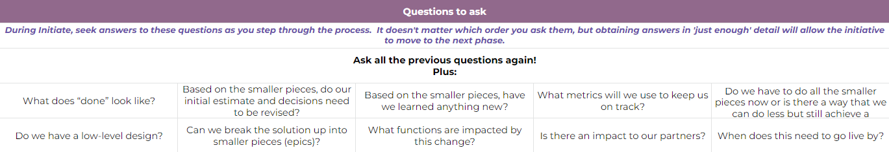
Hold the Workshop(s)
During the Initiate Workshop(s) you will:
Review high level scope in/out (from Concept phase)
Define the personas that are impacted by this change
Complete journey mapping, data mapping, wire frames techniques to arrive at feature sets
Break the feature sets into epics, using story mapping
Define done for each story, task, activity
Prioritise the epics / stories
Break the epics into stories (by user type), task (technical teams), activities (team deliverables)
Perform RAIDS (include Risk Management pack)
Agree delivery approach (including number of releases)
Size the work units (estimation)
Build Release Plan
Tip: You can continue to extend on the Concept Workshop Miro board to facilitate discussion in the Initiate workshop https://miro.com/app/board/o9J_lghFnnY=/
See the FLOW 2.0 One Pager for questions to ask during Initiate phase, and the Initiate Workshop.

Slide 12
Supporting Activities
Following the Initiate Workshop, a number of other activities may need to be completed in readiness for moving to ‘Deliver’ (depending on the size and complexity of your initiative).
These include:
Success and Acceptance workshop
Alignment and Dependency workshop
Release planning workshop
Delivery planning workshop

Slide 13
Approval To Proceed
It is important to go back to the owner of the initiative, to ensure that the size of the work, and the planned approach, are acceptable.
The sponsor will agree that the team should move into Deliver phase and invest time in building this solution, or may park or cancel the initiative.

Slide 14
Reminder
All Concept activities and tools should be considered again for Initiate.

Slide 15
Outputs

Slide 16
Deliverables
Simple Change (Must)
Definition of Done (Release / Iteration)
Test Plan
Release Plan (High level delivery plan)
Communication Plan (Simple)
Showcase
Jira Backlog (Epics)
Solution Design
Note: Items from 'Complex Change' can be performed if they will add value to the Initiative or help in managing or communicating the work.
Complex Change (Should/Could)
Note: All 'Simple Change' outputs plus a selection of:
Project Reporting (Confluence Template)
Action / Decision Register
Risks and Issues
Steer Co Pack
Stakeholder Matrix
Test Strategy
Security Review
Communication Plan (Complex)
Note: ALL ITEMS FROM CONCEPT SHOULD BE CONTINUED TO BE REFINED. ALL DOCUMENTATION IS 'LIVING'.

Slide 17
Supporting Tools and Techniques
Examples of tools and techniques to support you during the Initiate workshop, and throughout Initiate phase.

Slide 18
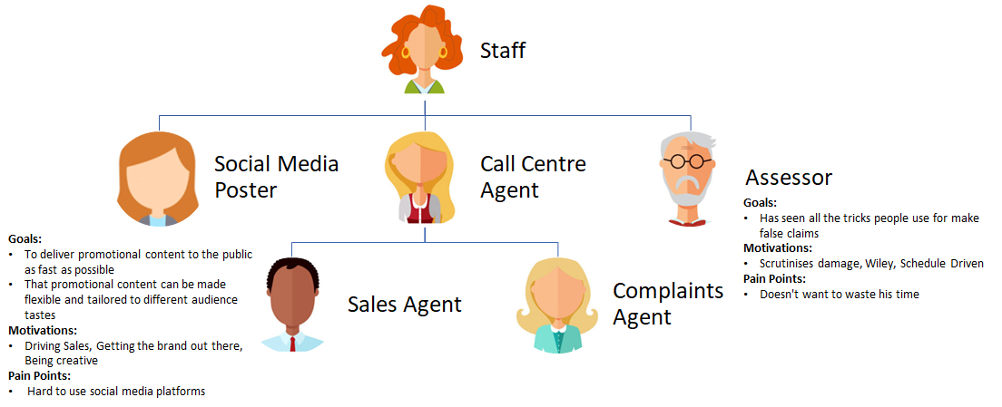
Tools – Personas
Creating fictional users to better understand their goals, desires and limitations in the context of using the solution. This is often used in conjunction with story mapping.
https://www.youtube.com/watch?v=lWjBYChP7JA

Slide 19
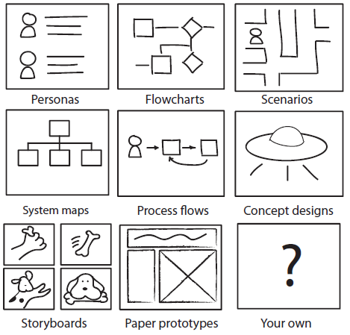
Tools - Design Sketching
Not everyone understands problems the same way – some like a document, some like it to be spoken and some like diagrams.
Collaborating on diagrams allows for all these learning styles to be incorporated so use the whiteboard (or virtual tools) wherever possible.

Slide 20
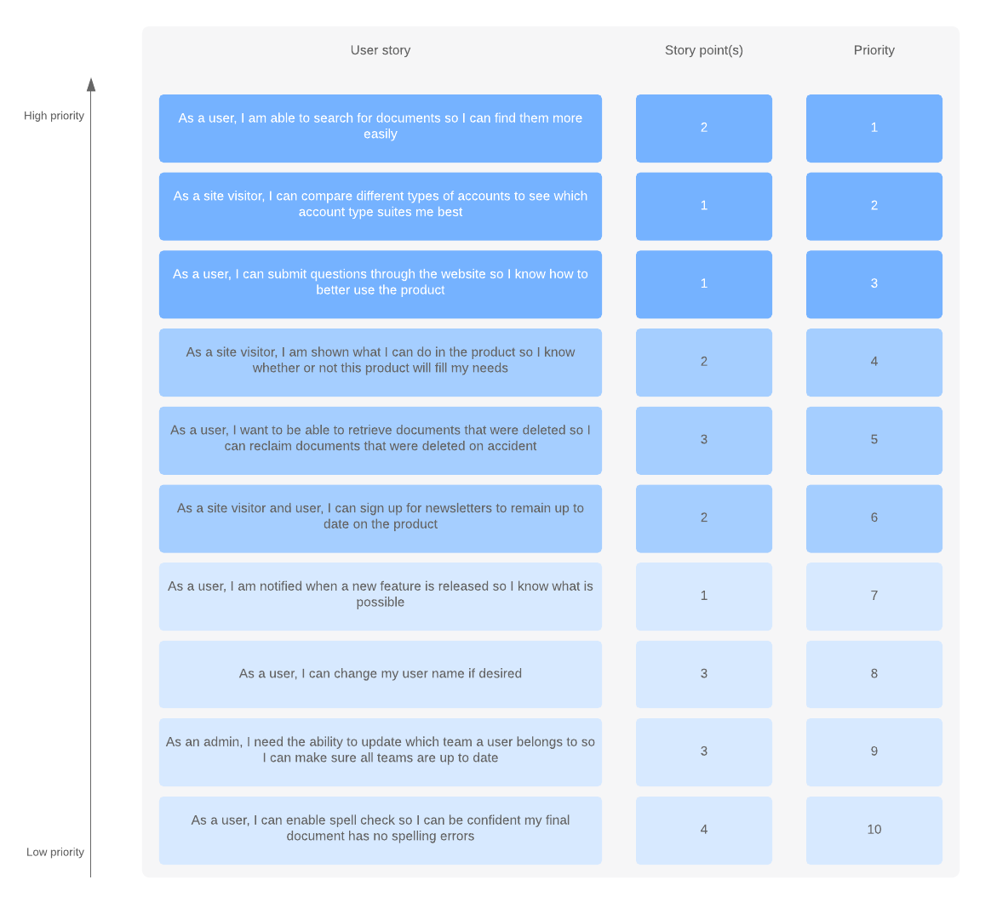
Tools - Backlog Definition
Placing all sequenced stories with estimates into the work management system (Jira) according to the WBS.
Enables ongoing prioritisation and planning.

Slide 21
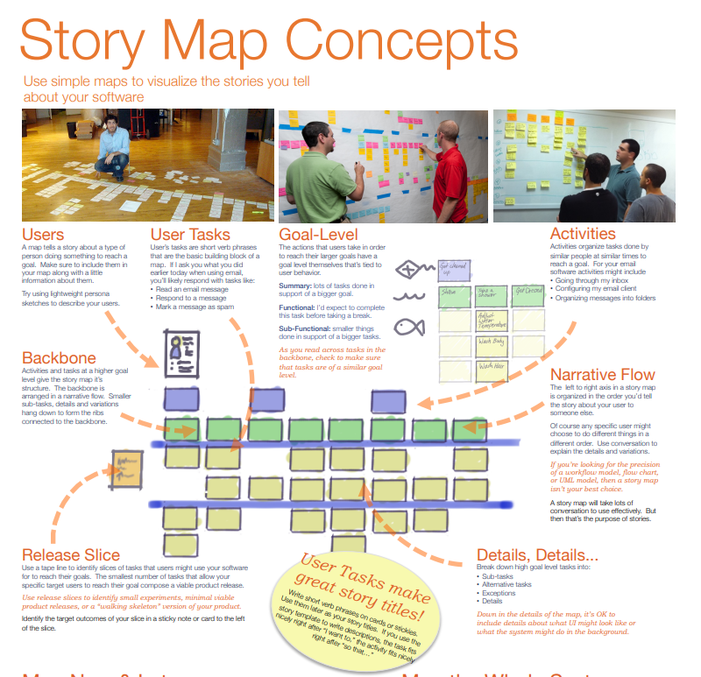
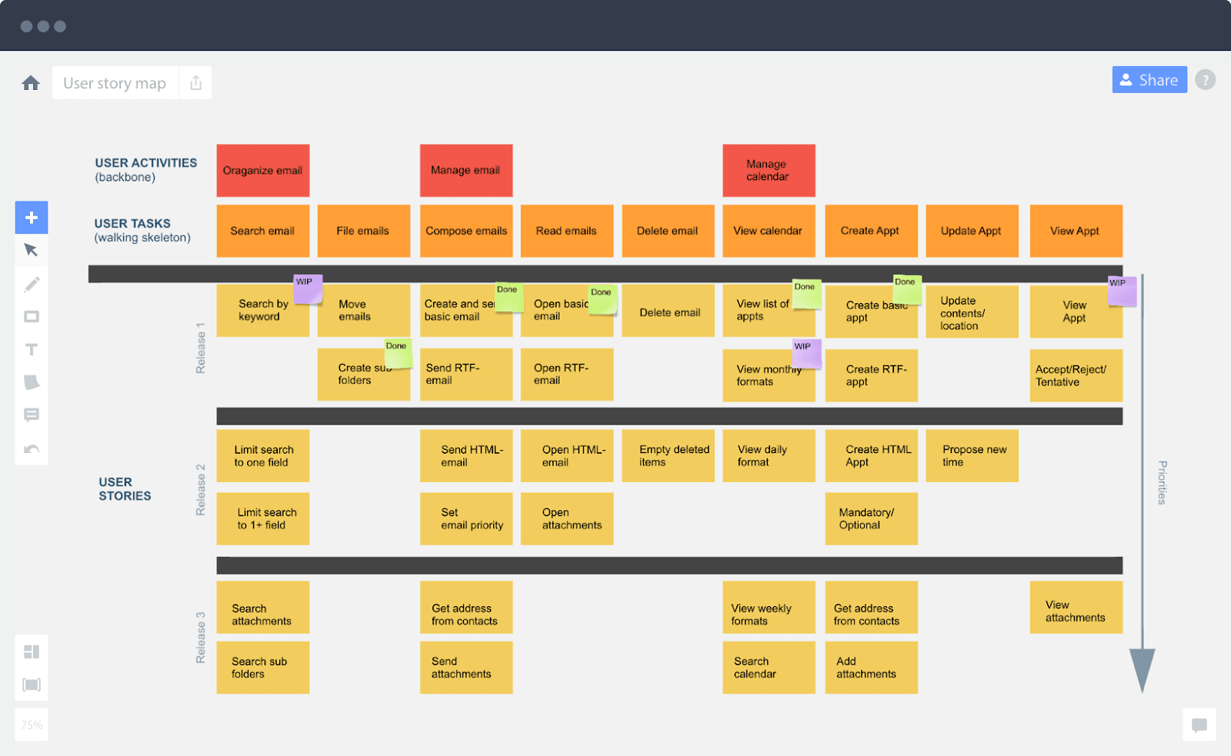
Story Mapping
http://www.jpattonassociates.com/wp-content/uploads/2015/03/story_mapping.pdf
Example:

Slide 22
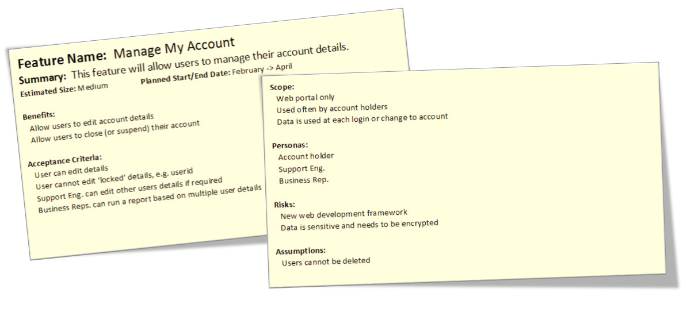
Tools – Epic Writing
Identifying and writing the stories that make up each feature. This will enable sequencing, estimation and planning.
Writing epics is the process of breaking the problem down into smaller pieces of valuable work.
By looking at the benefits, acceptance criteria, scope, personas, RAIDs, size we can start to validate
https://www.linkedin.com/pulse/writing-feature-card-mike-burns/

Slide 23
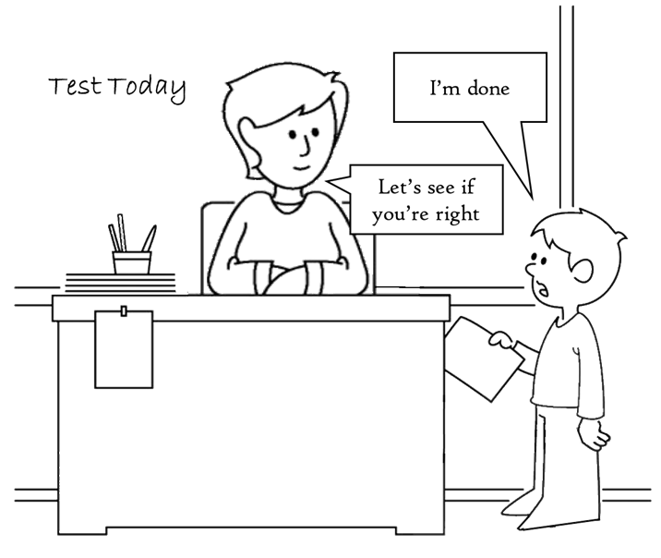
Tools - Defining Done
All the work required to deliver the solution. Release, Iteration and Story definitions of done should be considered. This helps to better forecast delivery of work.
By understanding the Definition of Done for the work, and the Acceptance Criteria you are able to create a work matrix – this can be your estimation reference point
Definition of Done is all the work required to deliver a piece of work – to “Acceptable” but not what makes it acceptable.
Definition of Done happens at many levels
Definition of Done is the basis for estimation
Definition of Done needs to be EXPLICIT

Slide 24
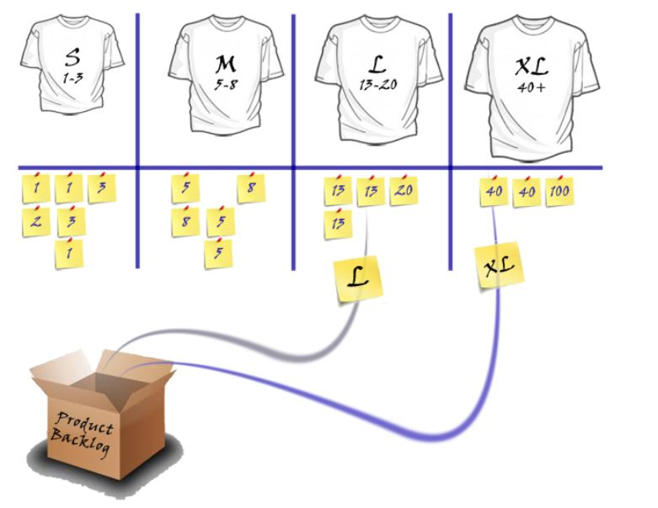
Tools - Work Estimation
Estimating the stories identified from Feature Breakdown.
Done using relative estimation to enable realistic forecasting.
Enables release planning and subsequently forecasting

Slide 25
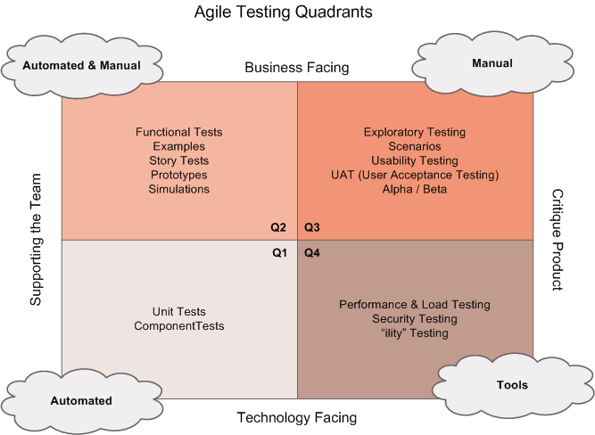
Tools - Test Strategy
Describes the testing approach for the delivery of the solution.
Helps to inform Definition of Done and Estimates.
The simplest form is to use the agile testing quadrants and ask for each quadrant (starting at Q1)
What are we testing?
How will we test it?
Do we have all the tools / people required to do the testing?
How much do we need to test?
Where will we test?

Slide 26
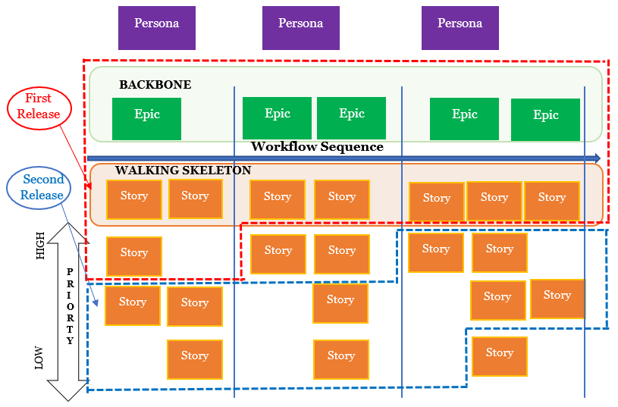
Tools - Sequencing
Placing stories in a sequence to be delivered.
Taking into consideration of dependencies and risk.
This is a form of prioritisation.
This enables release planning.

Slide 27
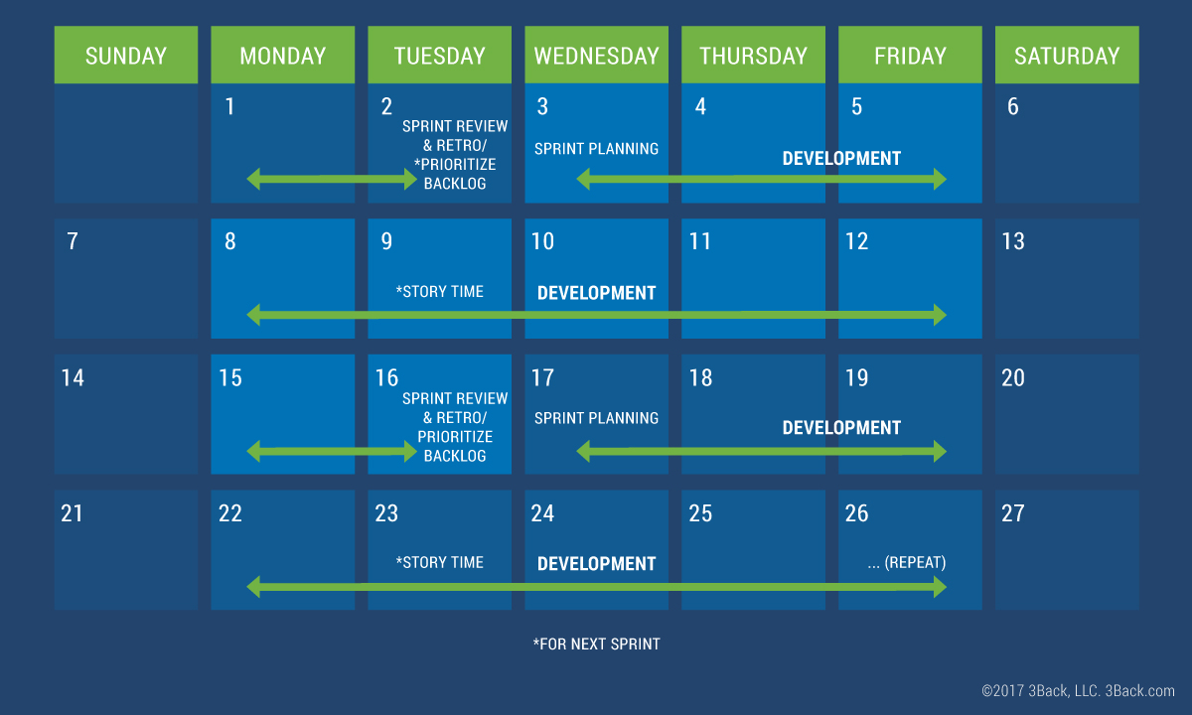
Tools – Release Planning
Define the time-box length in which stories will be delivered in a regular way.
This enables release planning.
Later this will be used to help plan team ceremonies.

Slide 28
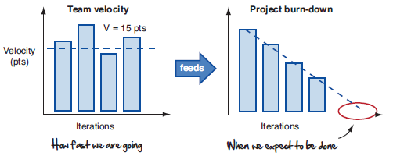
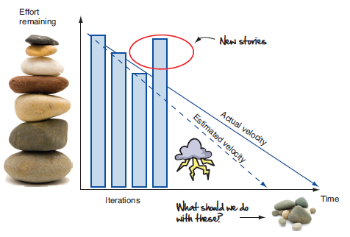
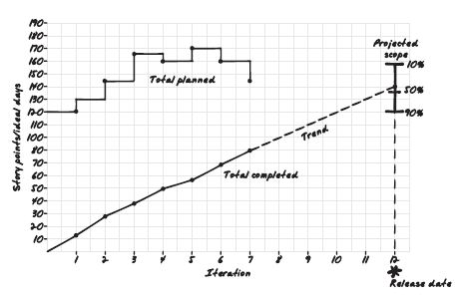
Tools – Historical Data
Data helps us to make the right decisions and can help predict our future actions. Burndown and burnup charts are great tools for this. Velocity is also a great indicator of future team performance.
But remember that predictions are an estimate – as you learn more you’ll generate more data which will help create better estimates.

Slide 29
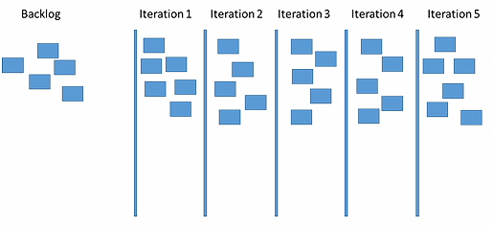

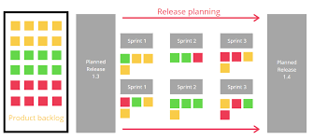
Tool - Release Plan
The activity of placing sequenced stories into iterations according to themes , MVP’s or delivery goals.
Full prioritised, estimated backlog, risk analysis, retrospective from last iteration/release; discussed and agreed
What’s the team’s velocity?
How many iterations do we need?
What’s the highest priority work?
What are the dependencies?
What are the risks

Slide 30
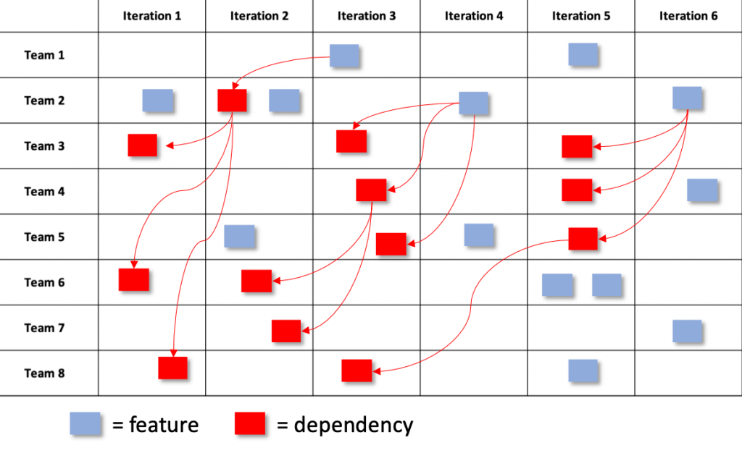
Tools - Dependency Identification
Identification of dependencies between stories.
Enables Sequencing and subsequently Release Planning.

Slide 31
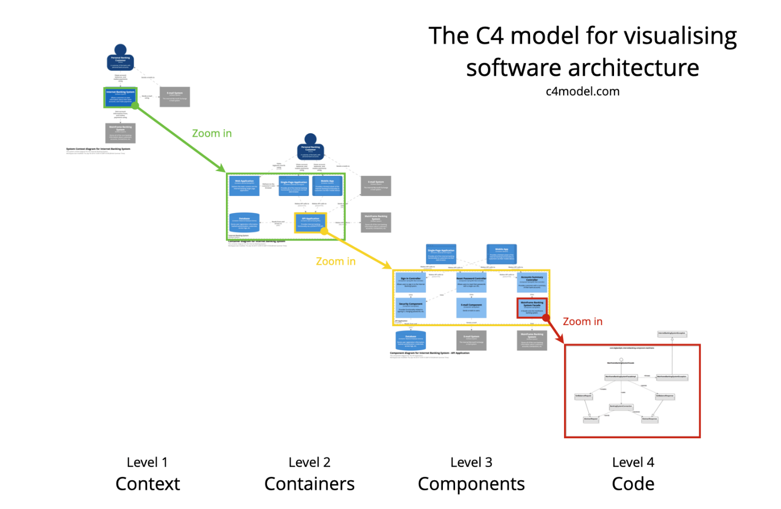
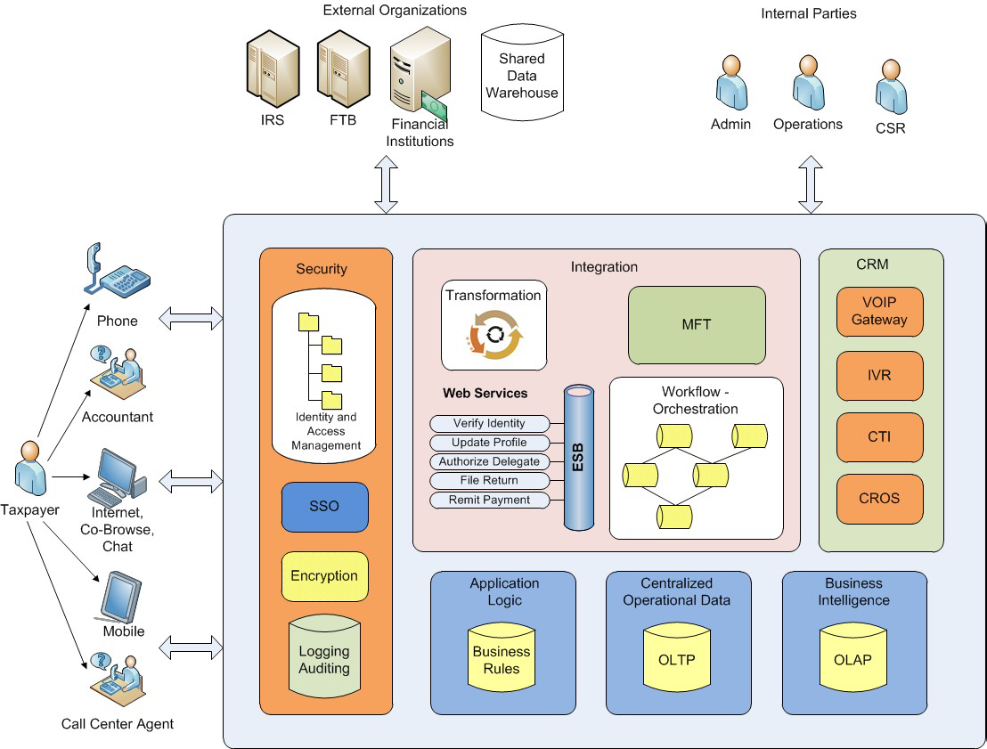
Tools – Architecture Diagrams
The recommended solution guides the identification of the features to be delivered. Features may be delivered internally through team or through the assistance of partners and vendors.

Slide 32
Tools - Risk Management
The approach taken to manage each identified risk.
Helps to identify extra work and prevent unnecessary time/cost/quality problems.
See the How to Guide - Risks & Issues

Slide 33
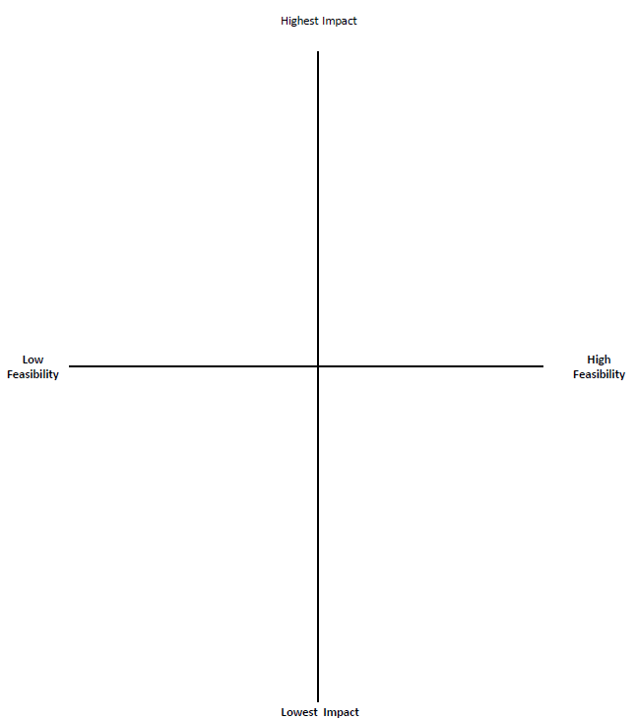
Tools - Prioritisation
A decision making technique used to rank a set of features and stories, helps to understand what is most important

Slide 34
Tools - Forecasting
Using the Release Plan, forecast how many iterations it will take to deliver the solution. If not all stories are planned then extrapolation techniques can be used.
Forecasting will provide an indicative end date.

Slide 35
Tools - Deployment Plan
A deployment plan defines all the activates needed to deploy a solution.
This includes software, infrastructure, training and communications.
More work maybe discovered as an outcome of this activity
Thing about
How often we will deploy?
What will we deploy?
Where will we deploy?
What happens if we need to un-do a deployment?
Who needs to approve deployments in each environment?
Can we batch deployments with other teams?
What risks are involved with batch deployments?
How will we track defects?
PLUS many others!

Slide 36
Operational Handover
A number of items must be considered as part of Operational Handover. This guidance is under construction.

Slide 37
Tools - Communications Plan
Update the Communications Plan to incorporate any changes to stakeholders or the method of communication.
Execute plan for Initiate phase.
Communication Plan - Link to Confluence page

Slide 38
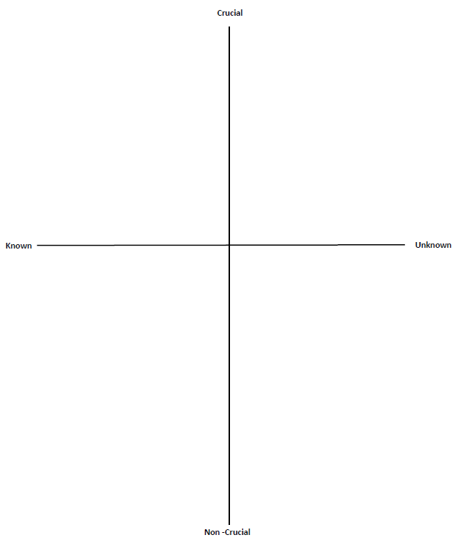
Tools – Assumption Mapping
This tool is used to map out assumptions you believe are critical to your solution and that, if proven untrue, would impact the ability of your solution to fix the problems you are trying to solve.​
You are looking for the riskiest assumptions in order to validate them as priority. Check for assumptions about the customer, the problem and the solution which need validating.
Include RAIDS
https://movestheneedle.com/exploration-tools/

